Slide 1
Scrum Methodology
Agile development framework

Slide 2
What is Scrum?
is an agile development methodology
the development of Software based on an iterative and incremental processes.
adaptable, fast, flexible and effective agile framework.
to satisfy the customer’s need through an environment of transparency in communication, collective responsibility and continuous progress.

Slide 3
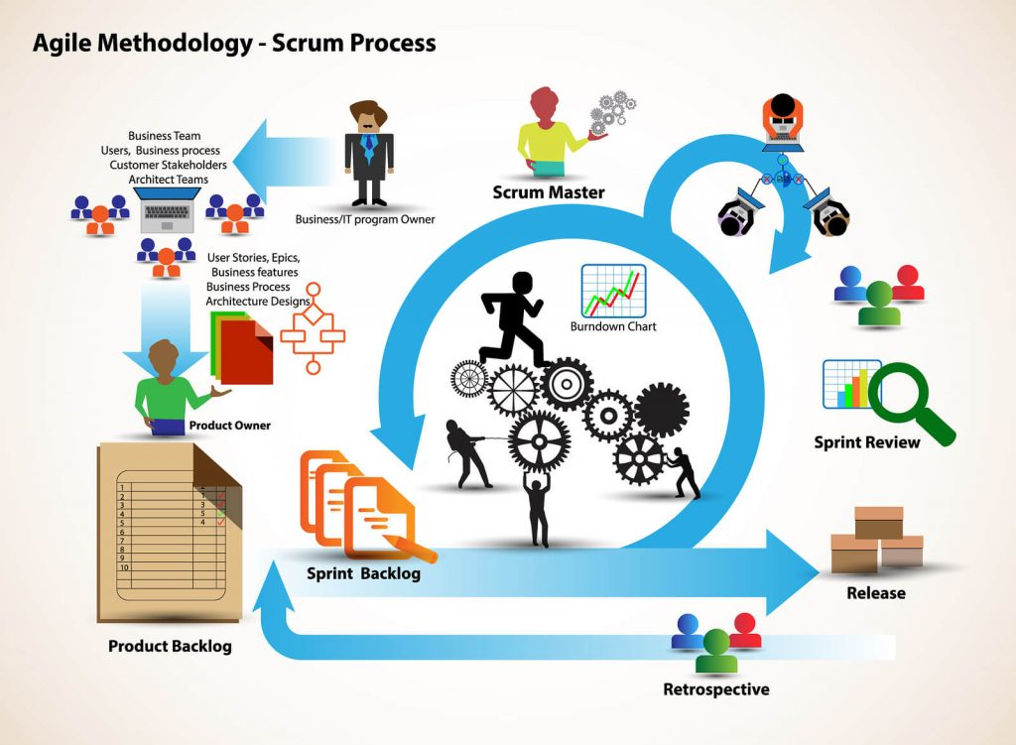

Slide 4
History on Scrum
to 1986 in the Harvard Business Review (HBR) article titled, “The New Product Development Game”
companies such as Honda, Canon, and Fuji-Xerox
influence to develop many of the concepts that gave birth to what we now call Scrum.
term drawn from Rugby, which refers to how the game is restarted after a foul or when the ball has left the game.

Slide 5

“Doing half of something is, essentially, doing nothing.” – Jeff Sutherland

Slide 6
Scrum Methodology & Process
an evolution of Agile Management
defined practices and roles that must be involved during the software development process.
flexible methodology
is used mainly for software development, but other sectors are also taking advantage of its benefits by implementing this methodology in their organizational models such as sales, marketing, & HR teams etc.

Slide 7
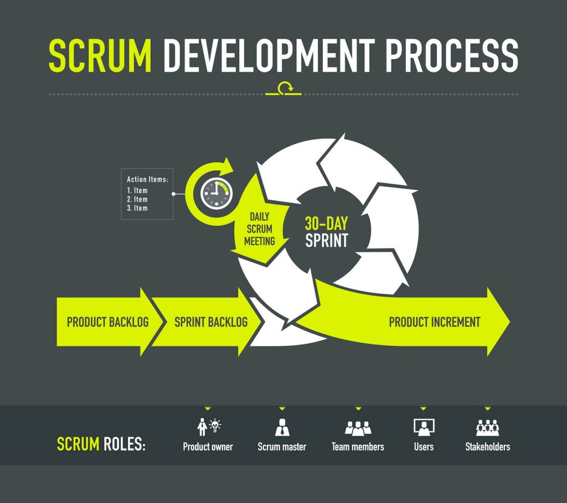

Slide 8
Benefits of Scrum Methodology
Easily Scalable
Compliance of expectations
Flexible to changes
Time to Market reduction
Higher software quality
Timely Prediction
Reduction of risks

Slide 9
For more information:
https://www.digite.com/agile/scrum-methodology/

